Slide 1


METI UniPods AI Innovation Programme
Cohort 1: Selection Results and Programme Overview
September 2026

Slide 2
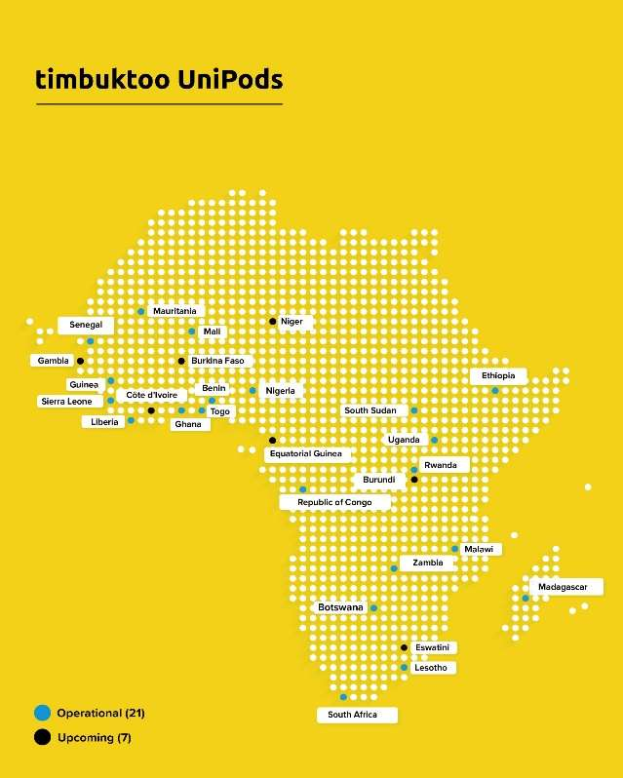
ABOUT THE PROGRAMME
AI skilling and venture building, funded by the Japanese Ministry of Economy, Trade and Industry(METI)
The METI UniPods AI Innovation Programme gives African innovators the technical skills, entrepreneurial grounding and support they need to advance in AI and turn their ideas into ventures. It is funded by the Japanese Ministry of Economy, Trade and Industry.
The programme builds a pipeline into the timbuktoo Hubs, UNDP's initiative supporting Africa's startup ecosystem through ten pan African hubs, with early stage capital, policy support and technical support.
UniPods are makerspaces inside public universities that support innovators from idea through prototyping, testing and market access. There are 23 UniPods across 21 countries today, with five more opening by December 2026.
METI UniPods AI Innovation Programme · Cohort 1
2

Slide 3
HOW SELECTION WORKED
From 584 applications to a cohort of 242
584
446
242
›
›
Applied to the
long list
Interviewed over
3 days
Selected into
Cohort 1
554 candidates were booked for interview; Of the 446 who were interviewed, 242 were selected into Cohort 1.
METI UniPods AI Innovation Programme · Cohort 1
3

Slide 4
SELECTED CANDIDATES
Where they are from
22
countries represented
in the selected cohort
The remaining 11 countries each contributed between 1 and 5 selected candidates, including Botswana, Eswatini, Lesotho, Madagascar, Mali and South Sudan.
METI UniPods AI Innovation Programme · Cohort 1
4

Slide 5
SELECTED CANDIDATES
Who they are
Gender
Claimed stage at interview
METI UniPods AI Innovation Programme · Cohort 1
5

Slide 6
SELECTED CANDIDATES
What they're building
METI UniPods AI Innovation Programme · Cohort 1
6

Slide 7
THE PROGRAMME
What selected teams receive
1
MIT: foundational AI
Self paced introduction to AI, Python and data analytics. Normally about USD 900, fully covered through a registration code.
2
Wadhwani Foundation: entrepreneurship
A 14 week instructor led journey from idea to a validated business model, with live sessions twice a week and mentorship.
3
Ethiopian AI Institute: advanced AI
Three months of intermediate to advanced AI content, leading to an in person bootcamp in Addis Ababa for the strongest teams.
METI UniPods AI Innovation Programme · Cohort 1
7

Slide 8
THE PROGRAMME
Key dates ahead
8 Sep
14 Sep
18 Oct
26 Oct
1 Dec
Welcome and onboarding call
MIT foundational AI course opens
MIT course completion expected
Ethiopian AI Institute programme begins
Addis Ababa bootcamp opens
10 Sep
15 Sep
25 Oct
23 Nov
17 Dec
Wadhwani welcome session
Wadhwani 14 week programme begins
Workplan submission deadline
50 teams selected for the bootcamp
Wadhwani programme concludes
All dates for 2026. Any changes are communicated through the WhatsApp group and by email.
METI UniPods AI Innovation Programme · Cohort 1
8

Slide 9
THE PROGRAMME
UniPod Rwanda pilots an Innovators Meetup
HOST
UniPod Rwanda, University of Rwanda (UR)
FRIDAY
11
VENUE
UniPod Rwanda
FREQUENCY
Monthly, starting this Friday
SEPTEMBER 2026
PURPOSE
Rwanda's 40 innovators selected into Cohort 1 will meet at the UniPod Rwanda, to showcase their work, build peer learning and collaboration between teams facing similar challenges, raise UniPod Rwanda's visibility as a hub in dialogue with the national innovation community, and encourage innovators who are not yet linked to a UniPod to connect with the one in their own country. It is piloted first at UniPod Rwanda, with the aim of other UniPods adopting the same model.
4:00 PM – 6:00 PM
METI UniPods AI Innovation Programme · Cohort 1
9

Slide 10
Cohort 1 is underway
242 teams from 22 countries are now moving through MIT, Wadhwani and the Ethiopian AI Institute.
Questions
unipods.regional@undp.org
METI UniPods AI Innovation Programme · Cohort 1
10

